Slide 1
NoSQL vs. NewSQL
Demystifying the Zoo of Contemporary Database Systems
ComputeFest
Niv Dayan
13 January, 2016

Slide 2


Introduction
Niv Dayan (post-doc)
IACS
Data Systems Lab
Research in database systems
Today’s workshop: NoSQL vs. NewSQL
Origin
Difference
Hype

Slide 3





Introduction
1980 1990 2000 2010
Time

Slide 4









Introduction
1980 1990 2000 2010
Time

Slide 5
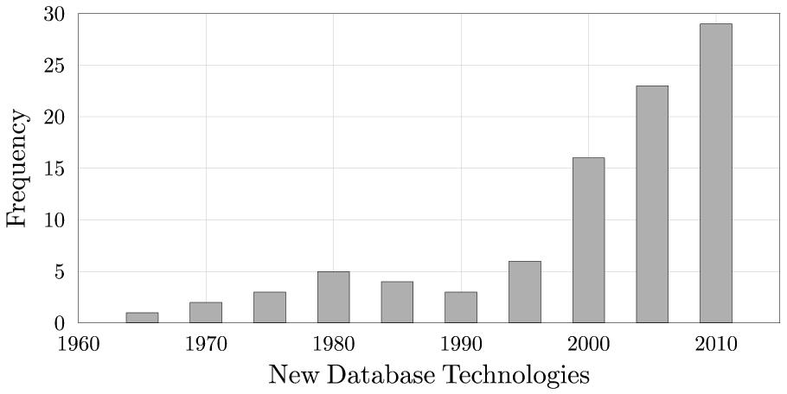
Introduction
Creation time of 100 most used databases (db-engines.com)

Slide 6
Introduction
Different architectures
Performance
Data integrity
User interface
“Which database system is right for me?”
Not a survey. Provide reasoning tools.

Slide 7


Introduction
Theme: any trend in database technology can be traced to a trend in hardware
Claim: The new database technologies are adaptations to changes in hardware
Database designer
Hardware

Slide 8
Introduction
Not just tell you how traditional databases are designed, but tell you why they are designed that way. Due to the hardware.
Modern times. How has hardware changed? What changes?
Two classes of databases today
Traditional systems 20 min
Changes in hardware 10 min
Market today 10 min
Analytical databases
Transactional databases
NoSQL 15 min
NewSQL 15 min
MongoDB Tutorial 30 min
Total: 90 minutes

Slide 9
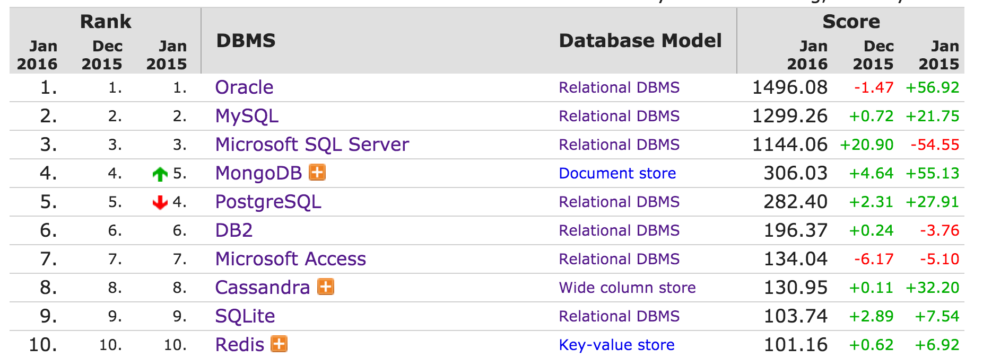
Introduction
Not just tell you how traditional databases are designed, but tell you why they are designed that way. Due to the hardware.
Modern times. How has hardware changed? What changes?
Two classes of databases today
MongoDB is the most popular NoSQL system

Slide 10
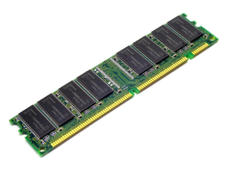
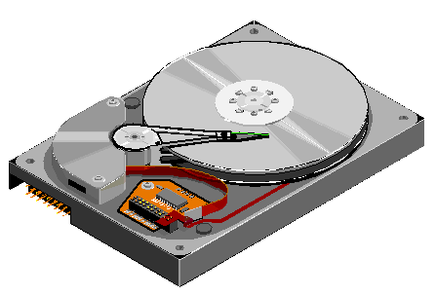
Traditional Systems (1/5)
In 1970, two storage technologies were becoming mature enough for the market
Dynamic Random Access Memory
Expensive, fast, volatile
Hard disk drives:
Cheap, slow, non-volatile

Slide 11
History

Slide 12
History
3 goals of database design
Speed
Affordability
Resilience to system failure
How you achieve them depends on hardware

Slide 13
History
Two storage media:
Main Memory
Fast, expensive, volatile
Disk
Slow, cheap, non-volatile

Slide 14
History
How should data be stored across them?
Main memory is volatile and expensive
Frequently accessed data
is here
All data
is here

Slide 15

History
To make a system fast, address bottleneck
Disk is extremely slow
Main memory
Fetch
Retrieve
Disk

Slide 16


History
To make a system fast, address bottleneck
Disk is extremely slow
Earth
Main memory
Fetch
Retrieve
Fetch
Retrieve
Disk
Pluto

Slide 17
History
Why so slow?
Two questions:
Question 1: How to minimize disk access?
Question 2: What to do during a disk access?
Disk hand moving

Slide 18
History
Problem: How to minimize disk accesses?
Solution: Store data that is frequently co-accessed at the same physical location
Consolidates many disk accesses to one
Data item 1
Data item 2

Slide 19
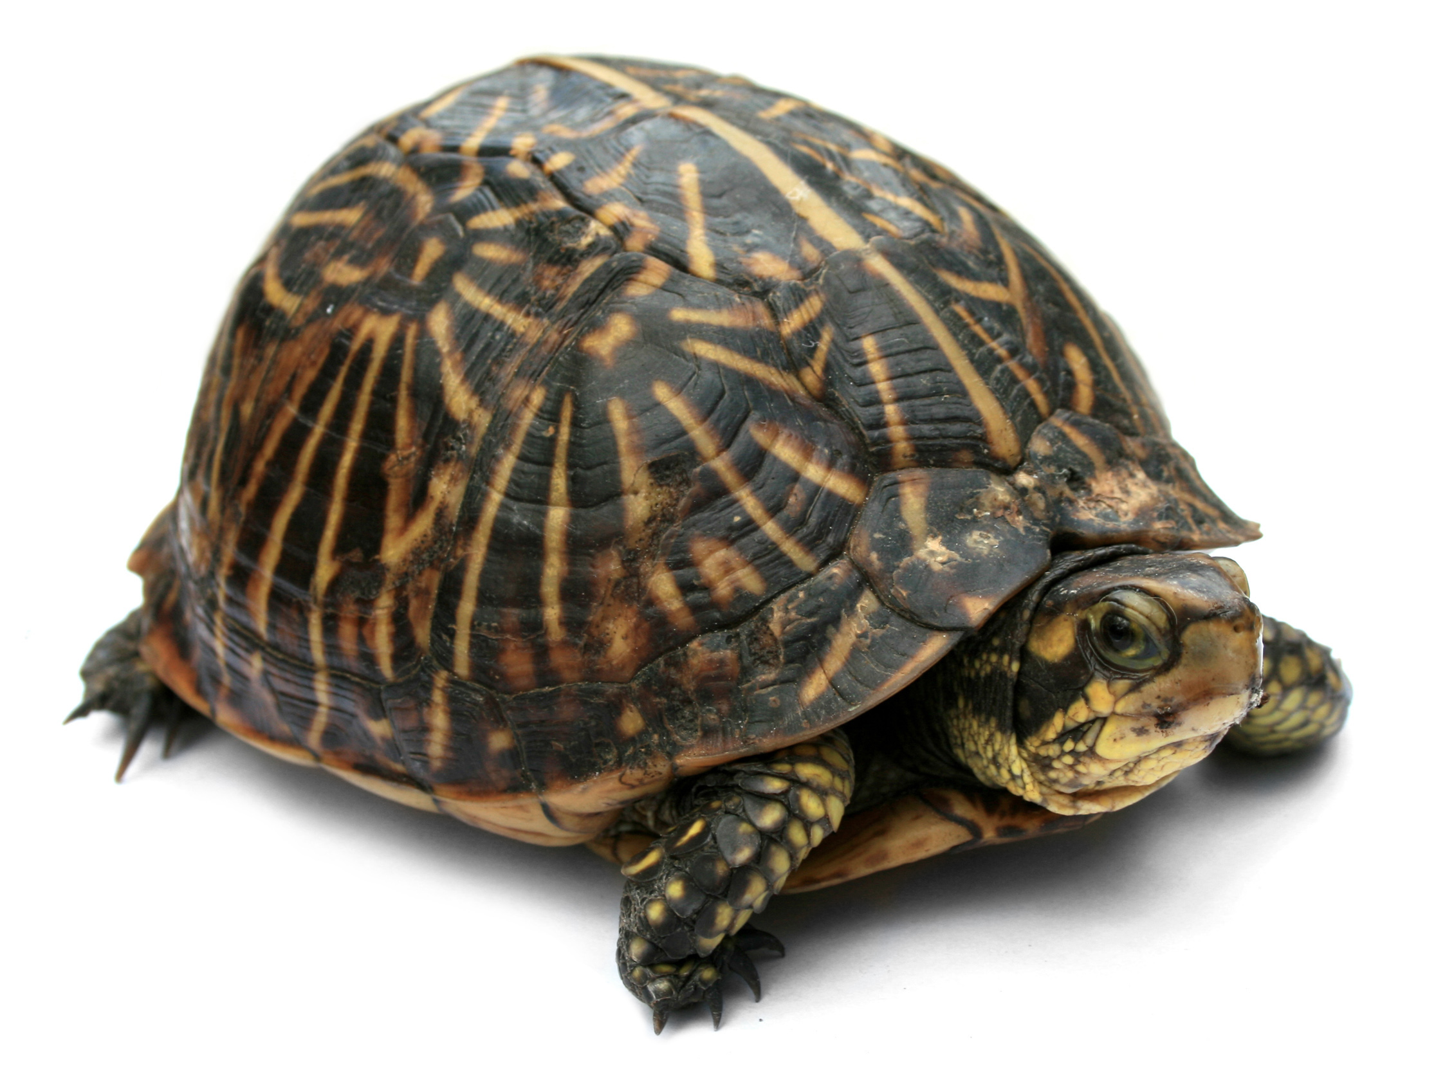
History (3/5)
How to minimize disk access?
Store data that is frequently accessed together in the same physical location
This gave rise to tabular structure

Slide 20
History
Example: Bank
Co-locate all information about each customer
Customer Sara deposits $100
2 disk accesses, since data about sara is co-located
Main
Memory
Add
100
2 | Sara | 200
ID | Name | Balance
1 | Bob | 100
2 | Sara | 100
3 | Trudy | 450
Disk
2 | Sara | 100
Database

Slide 21
History (1/7)
Challenge: power failures
Lose all information in main memory
Example: money transfer between two accounts
read Bob’s balance
subtract 100, and rewrite
Power Failure
read John’s balance
add 100, and rewrite

Slide 22
History (1/7)
Define a transaction as a logical unit of work
A transaction should happen fully, or not at all (atomicity)
Save all updates from transactions into a log
If power fails, redo committed transactions and undo uncommitted transactions

Slide 23
History (1/7)
Power failure example
Transfer between two bank accounts
T1: read account 1 balance
T1: subtract 100, and rewrite balance
Power Failure
T1: read account 2 balance
T1: add 100, and rewrite balance

Slide 24

History
What to do during a disk access?
Start running the next operation(s)
Improves performance
But data can get corrupted

Slide 25


History
A couple, Bob and Sara, share a bank account
Both deposit $100 at same time
balance = 0

Slide 26
History
A couple, Bob and Sara, share a bank account
Both deposit $100 at same time
balance = 0
Retrieve
Fetch
balance = 0

Slide 27
History
A couple, Bob and Sara, share a bank account
Both deposit $100 at same time
balance = 0
balance = 0

Slide 28
History
A couple, Bob and Sara, share a bank account
Both deposit $100 at same time
balance = 0
balance = 0
Retrieve
Fetch
balance = 0

Slide 29
History
A couple, Bob and Sara, share a bank account
Both deposit $100 at same time
balance = 0
balance = 0
balance = 0

Slide 30
History
A couple, Bob and Sara, share a bank account
Both deposit $100 at same time
balance = 100
balance = 100
balance = 0

Slide 31
History
A couple, Bob and Sara, share a bank account
Both deposit $100 at same time
balance = 100
balance = 100
write
write
balance = 100

Slide 32
History
A couple, Bob and Sara, share a bank account
Both deposit $100 at same time
balance = 100

Slide 33
History
A couple, Bob and Sara, share a bank account
Both deposit $100 at same time
Account balance should be 200!
Bob and Sara lost money.
balance = 100

Slide 34

History
Question: how to achieve concurrency while maintaining data integrity?
Insight: transactions can be concurrent, as long as they don’t modify the same data
Solution: locking
Bob locks data, modifies it, releases lock
Sara waits until lock is released
Downside:
transactions may need to wait for locks.

Slide 35

History (6/9)
Observation: data integrity is harder to achieve when data is replicated
Example: Sara deposits 100.
ID | name | account-ID | balance
1 | Bob | 1 | 0
2 | Sara | 1 | 0
3 | Trudy | 2 | 450
update

Slide 36
History (6/9)
Goal: hold locks for as little time as possible
Example: Suppose multiple copies of the same data exist. Sara deposits 100.
ID | name | account-ID | balance
1 | Bob | 1 | 100
2 | Sara | 1 | 0
3 | Trudy | 2 | 450
update

Slide 37
History (6/9)
Goal: hold locks for as little time as possible
Example: Suppose multiple copies of the same data exist. Sara deposits 100.
ID | name | account-ID | balance
1 | Bob | 1 | 100
2 | Sara | 1 | 0
3 | Trudy | 2 | 450
update

Slide 38
History (6/9)
Goal: hold locks for as little time as possible
Example: Suppose multiple copies of the same data exist. Sara deposits 100.
ID | name | account-ID | balance
1 | Bob | 1 | 100
2 | Sara | 1 | 100
3 | Trudy | 2 | 450
update

Slide 39
History (6/9)
Goal: hold locks for as little time as possible
Example: Suppose multiple copies of the same data exist. Sara deposits 100.
ID | name | account-ID | balance
1 | Bob | 1 | 100
2 | Sara | 1 | 100
3 | Trudy | 2 | 450

Slide 40
History (6/9)
Goal: hold locks for as little time as possible
Example: Suppose multiple copies of the same data exist. Sara deposits 100.
ID | name | account-ID | balance
1 | Bob | 1 | 100
2 | Sara | 1 | 100
3 | Trudy | 2 | 450
Problem: We must scan entire table. Meanwhile, locks are held for a long time.

Slide 41
History
3 goals of database design
Speed
Affordability
Resilience to system failure

Slide 42
History
3 goals of database design
Speed
Affordability
Resilience to system failure

Slide 43
History
Disk was cheap, but not so cheap
1 gigabyte for $1000 in 1980
Avoid storing replicas of same data
ID | name | account-ID | balance
1 | Bob | 1 | 100
2 | Sara | 1 | 100
3 | Trudy | 2 | 450

Slide 44
History
Solution: “Normalization”. Break tables.
ID | name | account-ID | balance
1 | Bob | 1 | 100
2 | Sara | 1 | 100
3 | Trudy | 2 | 450
Customers
Accounts
ID | name | account-ID
1 | Bob | 1
2 | Sara | 1
3 | Trudy | 2
ID | balance
1 | 100
2 | 450
Bonus: Easier to maintain data integrity

Slide 45
History
Normalization:
Saves storage space
Easier to maintain data integrity
Downside: reads are more expensive
Need to join tables
Customers
Accounts
ID | name | account-ID
1 | Bob | 1
2 | Sara | 1
3 | Trudy | 2
ID | balance
1 | 100
2 | 450

Slide 46
History
Data is decomposed accross tables
Query Language: SQL
select balance from Customers c, Accounts a where c.account-ID = a.ID and c.name = “Bob”
Customers
Accounts
ID | name | account-ID
1 | Bob | 1
2 | Sara | 1
3 | Trudy | 2
ID | balance
1 | 100
2 | 450

Slide 47
History
3 goals of database design
Speed
Affordability
Resilience to system failure

Slide 48
History
3 goals of database design
Speed
Affordability
Resilience to system failure

Slide 49
History
Many things can go wrong
Power failure
Hardware failure
Natural disaster
Data is precious (e.g. bank)
Provide recovery mechanism

Slide 50

History
Example: Sara transfers $100 to Trudy
Power stops in the middle
Sara’s
balance = 0
Sara’s
balance = 100
Sara’s
balance = 100
Trudy’s
balance = 450

Slide 51
History
Example: Sara transfers $100 to Trudy
Power stops in the middle
Sara’s
balance = 0
Sara’s
balance = 100
Trudy’s
balance = 450

Slide 52
History
Example: Sara transfers $100 to Trudy
Power stops in the middle
Trudy’s
balance = 550
Sara’s
balance = 0
Trudy’s
balance = 450
Trudy’s
balance = 450

Slide 53
History
Example: Sara transfers $100 to Trudy
Power stops in the middle
At this point, power fails
Trudy’s
balance = 550
Sara’s
balance = 0
Trudy’s
balance = 450
Trudy’s
balance = 450

Slide 54
History
Transaction: a sequence of operations all takes place, or none take place.
Transactions should be atomic

Slide 55
History
Problem: how to guarantee atomicity?
Solution: use a log (in disk )
All data changes are recorded in the log
After power failure, examine log
Undo changes by unfinished transactions
Data
Log

Slide 56
History
Data integrity
Concurrency (fix with locking)
System failure (fix with logging)
ACID
Atomicity
Consistency
Isolation
Durability

Slide 57
History
Summary
Speed
Affordability
Resilience to system failure
Relational databases:
Normalize data into multiple tables
ACID (locking & logging)
SQL
Design decisions are motivated by hardware

Slide 58
Today

Slide 59
Today
What changed in hardware?
How does it affect database design?

Slide 60
Today
Disk is 10⁷ times cheaper
Main memory is 10⁶ times cheaper

Slide 61
Today
Disk is now dirt cheap
Organizations keep all historical data
Business intelligence
E.g. Amazon
revenues from product X on date Y
which products are bought together

Slide 62


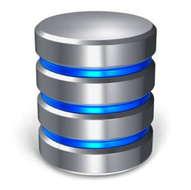
Today
Traditional system architecture:
Analytical queries
transactions
Transactional
Database
Business
Intelligence
End users

Slide 63
Today
Problem:
Analytical queries are expensive
Touch a lot of data
Disk access
Locks
They slow down transactions.
End-users wait longer

Slide 64

Today
Solution: split database
Transactional
Database
Data
warehouse
Business
Intelligence
End users

Slide 65
Today
Different workloads
Different internal design
Transactional
Database
Data
warehouse

Slide 66
Today
order id | cust id | product id | price | order date | receipt date | priority | status | comment
... | ... | ... | ... | ... | ... | ... | ... | ...
Example analytical queries
How long is delivery? (2 columns, all rows)
Revenue from product X? (2 columns, all rows)
Problem:
Data is stored row by row

Slide 67
Today
order id |  | cust id |  | status |  | price |  | order date |  | receipt date |  | priority |  | clerk |  | comment
... |  | ... |  | ... |  | ... |  | ... |  | ... |  | ... |  | ... |  | ...
Solution: column-store
Each column is stored separately
Good for analytical queries
Changes entire architecture
Examples: Vertica, Vectorwise, Greenplum, etc.

Slide 68
Today
How are transactional databases affected by hardware changes?
Transactional
Database

Slide 69
Today
Main memory is cheaper
Terabytes are affordable
Enough to store all transactional data
E.g. Amazon
Products list
User accounts

Slide 70
Today
Main memory was expensive
Now it’s cheaper
Data
Log

Slide 71
Today
Transactional databases are main memory databases
Bottleneck used to be disk access
The new bottleneck is ACID (logging, locking)

Slide 72
Today
More challenges
Due to internet, 100% availability is key
Data is replicated
…
…

Slide 73
Today
Joins become more expensive
Joins
Customers
Accounts
ID | name | account-ID
1 | Bob | 1
2 | Sara | 1
3 | Trudy | 2
ID | balance
1 | 100
2 | 450

Slide 74
Today
Replication and locks become more expensive
Replication, locks
Accounts
Accounts
ID | balance
1 | 100
2 | 450
ID | balance
1 | 100
2 | 450

Slide 75
Today
Single machine bottlenecks:
Multiple machine bottlenecks:
Logging & locking
Replication, locks, joins

Slide 76
Today
NoSQL and NewSQL address these
NoSQL simplifies
NewSQL engineers

Slide 77
NoSQL
(MongoDB)

Slide 78
NoSQL
Name popularized in 2009
Conference on “open source distributed non-relational databases”
NoSQL was a hashtag

Slide 79




NoSQL
Different types
Document stores
Column-oriented
Key-value-stores
Graph databases
Similar
Different

Slide 80
NoSQL
MongoDB - Main decisions
No joins
Aggregate related data into “documents”
Reduces network traffic
Data modeling is harder
No ACID
Faster
Concurrency & system failure can corrupt data

Slide 81
NoSQL
Single machine bottlenecks:
Multiple machine bottlenecks:
Logging & locking
Replication, locks, joins

Slide 82
NoSQL
To avoid joins, data is de-normalized
Customers
Accounts
ID | name | account-ID
1 | Bob | 1
2 | Sara | 1
3 | Trudy | 2
ID | balance
1 | 100
2 | 450
ID | name | account-ID | balance
1 | Bob | 1 | 100
2 | Sara | 1 | 100
3 | Trudy | 2 | 450

Slide 83
NoSQL
In MongoDB
db.customers.find(name:“Sara”)
{ name: “Bob”,
account-ID: 1,
balance: 100 }
Collection of customer Documents
{ name: “Sara”,
account-ID: 1,
balance: 100 }
{ name: “Trudy”,
account-ID: 2,
balance: 450 }

Slide 84
NoSQL
Documents are flexible
{ name: “Bob”,
account-ID: 1,
balance: 100,
favorite-color: “red”
credit-score: 3.0
}
{ name: “Sara”,
account-ID: 1,
balance: 100
hobbies: [“rowing”, “running”]
}

Slide 85
NoSQL
Main point: no need for joins
All related data is in one place
{ name: “Bob”,
account-ID: 1,
balance: 100,
favorite-color: “red”
credit-score: 3.0
}

Slide 86
NoSQL
Single machine bottlenecks:
Multiple machine bottlenecks:
Logging & locking
Replication, locks, joins

Slide 87
NoSQL
MongoDB does not lock
Recall Bob and Sara
Deposit $100 at same time to shared account
Overwrite each other’s update
No general way to prevent this

Slide 88
NoSQL
Single machine bottlenecks:
Multiple machine bottlenecks:
Logging & locking
Replication, locks, joins

Slide 89
NoSQL(1/3)
To some extent
Model accounts instead
An account can have multiple holders
Solves problem, but limited
{ name: “Bob”,
account-ID: 1,
balance: 100 }
{ account-id: 1,
balance: 100
holders: [
{name : “Bob” }
{name : “Sara” }
]
}
merge
{ name: “Sara”,
account-ID: 1,
balance: 100 }

Slide 90
NoSQL(1/3)
Suppose a customer has multiple accounts
An account can have multiple holders
Two clerks update the credit score at the same time, and overwrite each other’s changes
{ account-id: 1,
balance: 100
holders: [
{name : “Bob”
credit-score: 1 }
{name : “Sara” }
]
}
{ account-id: 3,
balance: 200
holder: „Bob“
credit-score: 1
}

Slide 91
NoSQL(1/3)
Problem: many-to-many relationships
Example: customer can have multiple accounts, and account can be shared by multiple customers.
In MongoDB, choose 2 of 3:
Concurrency (performance)
Correctness
Many-to-many relationships

Slide 92
NoSQL
Different operation order across replicas
E.g. concurrent addition and multiplication
Deposit
Add 100
Interest
Multiply by 1.1
{ …
balance: 100
... }
{ …
balance: 100
... }

Slide 93
NoSQL
Different operation order across replicas
E.g. concurrent addition and multiplication
Deposit
Add 100
Interest
Multiply by 1.1
{ …
balance: 100
... }
{ …
balance: 100
... }

Slide 94
NoSQL
Operation order may be different
E.g. concurrent addition and multiplication
Deposit
Add 100
Interest
Multiply by 1.1
{ …
balance: 220
... }
Inconsistent replicas
{ …
balance: 210
... }

Slide 95
NoSQL
Single machine bottlenecks:
Multiple machine bottlenecks:
Logging & locking
Replication, locks, joins

Slide 96
NoSQL
When to use MongoDB?
You need a flexible data model
Non-interacting entities
No sharing (e.g. bank account)
No exchanging (e.g. money transfers)
Commutative operations on data

Slide 97
NewSQL
(VoltDB)

Slide 98
NewSQL
ACID & good performance
Redesign internal architecture.

Slide 99
NewSQL
Data is normalized into multiple tables
Tables partitioned and replicated across machines
Customers
Accounts
ID | name | account-ID
1 | Bob | 1
2 | Sara | 1
3 | Trudy | 2
ID | balance
1 | 100
2 | 450

Slide 100
NewSQL
Single machine bottlenecks:
Multiple machines bottlenecks:
Logging & locking
Replication, locks, joins

Slide 101
NewSQL
History: concurrent transactions were introduced since disk was slow
Today: Now all data is in main memory
Transactions in main memory are fast
Less need for concurrency
VoltDB removes concurrency
Thus, no need for locking

Slide 102
NewSQL
Recall Bob and Sara
Deposit $100 at same time to shared account
Overwrite each other’s update
In VoltDB, this cannot happen

Slide 103
NewSQL
Single machine bottlenecks:
Multiple machine bottlenecks:
Logging & locking
Replication, locks, joins

Slide 104
NewSQL
History: log introduced for recovery
Today: it takes too long to recover from log
Instead, replicate data across machines
If one machine fails, others continue working
Simplifies logging

Slide 105
NewSQL
Single machine bottlenecks:
Multiple machine bottlenecks:
Logging & locking
Replication, locks, joins

Slide 106
NewSQL
Try to avoid joins across machines
Store data that is commonly accessed at same time on same machine
Customers
Customers
ID | name | account-ID
1 | Bob | 1
2 | Sara | 1
ID | name | account-ID
3 | Trudy | 2
Accounts
Accounts
ID | balance
1 | 100
ID | balance
2 | 450

Slide 107
NewSQL
Alleviates problem
Does not solve it (e.g. money transfer)
Customers
Customers
ID | name | account-ID
1 | Bob | 1
2 | Sara | 1
ID | name | account-ID
3 | Trudy | 2
Accounts
Accounts
ID | balance
1 | 100
ID | balance
2 | 450

Slide 108
NewSQL
Single machine bottlenecks:
Multiple machine bottlenecks:
Logging & locking
Replication, locks, joins

Slide 109
NewSQL
Consistency over replicas
Enforce operation order across replicas
Deposit
Add 100
Interest
Multiply by 1.1
ID | balance
... | 100
ID | balance
... | 100

Slide 110
NewSQL
Tables are replicated
Enforce operation order across replicas
Deposit
Add 100
Interest
Multiply by 1.1
ID | balance
... | 100
ID | balance
... | 100

Slide 111
NewSQL
Tables are replicated
Enforce operation order across replicas
Deposit
Add 100
Interest
Multiply by 1.1
ID | balance
... | 200
ID | balance
... | 200

Slide 112
NewSQL
Tables are replicated
Enforce operation order across replicas
Deposit
Add 100
Interest
Multiply by 1.1
ID | balance
... | 200
ID | balance
... | 200

Slide 113
NewSQL
Tables are replicated
Enforce operation order across replicas
Deposit
Add 100
Interest
Multiply by 1.1
ID | balance
... | 200
ID | balance
... | 200

Slide 114
NewSQL
Tables are replicated
Enforce operation order across replicas
Deposit
Add 100
Interest
Multiply by 1.1
ID | balance
... | 220
ID | balance
... | 220

Slide 115
NewSQL
Tables are replicated
Enforce operation order across replicas
Deposit
Add 100
Interest
Multiply by 1.1
ID | balance
... | 220
ID | balance
... | 220

Slide 116
NewSQL
Single machine bottlenecks:
Multiple machine bottlenecks:
Logging & locking
Replication, locks, joins

Slide 117
Summary(1/3)
Paradox:
Past:
serial computers
concurrent transactions
Today:
concurrent computers
serial transactions

Slide 118
NewSQL
When to use VoltDB?
run at scale
You need 100% availability
You need ACID

Slide 119
Conclusion

Slide 120
Conclusion
Hardware is cheaper

Slide 121
Conclusion
Transactional
Database
Data
warehouses
Row-store
Column-store

Slide 122
Conclusion
Single machine bottlenecks:
Multiple machines bottlenecks:
Logging & locking
Replication, locks, joins

Slide 123
Conclusion
NoSQL adapts by simplifying
No ACID
No joins
NewSQL adapts by reengineering
ACID
Removes concurrency
Simplifies logging
Smart but limited partitioning across servers

Slide 124


Conclusion
Disclaimer: there is much more
Scientific databases:
Time series databases:
Graph databases
Caveat: rapid changes
But hopefully now you have reasoning tools

Slide 125
Conclusion
Thanks!
nivdayan.github.io/mongo.pdf

